Slide 1
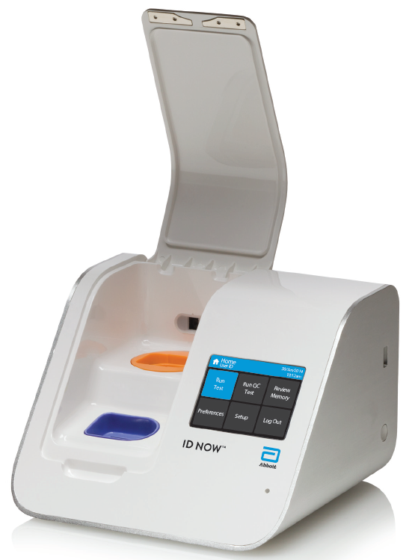
ID NOW™ Instrument
End User Training
Abbott Technical Consultant
James Thom Johnson
1/27/2023

Slide 2
Intended Use
Assay Type | Intended Use Statement
ID NOW™ Influenza A & B 2 | The ID NOW™ Influenza A & B 2 assay performed on the ID NOW Instrument is a rapid molecular in vitro diagnostic test utilizing an isothermal nucleic acid amplification technology for the qualitative detection and discrimination of influenza A and B viral RNA in direct nasal or nasopharyngeal swabs and nasal or nasopharyngeal swabs eluted in viral transport media from patients with signs and symptoms of respiratory infection. It is intended for use as an aid in the differential diagnosis of influenza A and B viral infections in humans in conjunction with clinical and epidemiological risk factors. The assay is not intended to detect the presence of influenza C virus. Negative results do not preclude influenza virus infection and should not be used as the sole basis for diagnosis, treatment or other patient management decisions. If infection with a novel influenza A virus is suspected based on current clinical and epidemiological screening criteria recommended by public health authorities, specimens should be collected with appropriate infection control precautions for novel virulent Influenza viruses and sent to state or local health department for testing. Viral culture should not be attempted in these cases unless a BSL 3+ facility is available to receive and culture specimens.

Slide 3
Intended Use
Assay Type | Intended Use Statement
ID NOW™ Strep A 2 | ID NOW™ Strep A 2 is a rapid, instrument-based, molecular in vitro diagnostic test utilizing isothermal nucleic acid amplification technology for the qualitative detection of Streptococcus pyogenes, Group A Streptococcus bacterial nucleic acid in throat swab specimens obtained from patients with signs and symptoms of pharyngitis. It is intended to aid in the rapid diagnosis of Group A Streptococcus bacterial infections

Slide 4
Intended Use
Assay Type | Intended Use Statement
ID NOW™ RSV | The ID NOW™ RSV assay performed on the ID NOW Instrument is a rapid molecular in vitro diagnostic test utilizing an isothermal nucleic acid amplification technology for the qualitative detection of respiratory syncytial virus (RSV) viral RNA in direct nasopharyngeal swabs and nasopharyngeal swabs eluted in viral transport media from patients with signs and symptoms of respiratory infection. It is intended for use as an aid in the diagnosis of RSV in children <18 years and adults ≥60 years in conjunction with clinical and epidemiological risk factors.

Slide 5
Intended Use
Assay Type | Intended Use Statement
ID NOW™ COVID-19 2.0 (EUA) | The ID NOW™ COVID-19 2.0 assay performed on the ID NOW Instrument is a rapid molecular in vitro diagnostic test utilizing an isothermal nucleic acid amplification technology (NAAT) intended for the qualitative detection of nucleic acid from the SARS-CoV-2 in direct anterior nasal (nasal) or nasopharyngeal specimens from individuals who are suspected of COVID-19 by their healthcare provider within the first seven days of the onset of symptoms. Results are for the identification of SARS-CoV-2 RNA. The SARS-CoV-2 RNA is generally detectable in respiratory samples during the acute phase of infection. Positive results are indicative of the presence of SARS-CoV-2 RNA; clinical correlation with patient history and other diagnostic information is necessary to determine patient infection status. Positive results do not rule out bacterial infection or co-infection with other viruses. The agent detected may not be the definite cause of disease. Testing facilities within the United States and its territories are required to report all results to the appropriate public health authorities. Negative results should be treated as presumptive and, if inconsistent with clinical signs and symptoms or necessary for patient management, should be confirmed with a different authorized or cleared molecular test in a CLIA-certified laboratory that meets requirements to perform high or moderate complexity tests. Negative results do not preclude SARS-CoV-2 infection and should not be used as the sole basis for patient management decisions. Negative results must be combined with clinical observations, patient history, and/or epidemiological information.

Slide 6
ID NOW™ COVID-19 2.0 Emergency Use Authorization (EUA)
The ID NOW™ COVID-19 2.0 EUA has not been FDA cleared or approved. It has been authorized by the FDA under an emergency use authorization for use by authorized laboratories and patient care settings. The test has been authorized only for the detection of nucleic acid from SARS-CoV-2, not for any other viruses or pathogens, and is only authorized for the duration of the declaration that circumstances exist justifying the authorization of emergency use of in vitro diagnostic tests for detection and/or diagnosis of COVID-19 under Section 564(b)(1) of the Act, 21 U.S.C. § 360bbb-3(b)(1), unless the authorization is terminated or revoked sooner.
Authorized laboratories that receive the ID NOW™ COVID-19 2.0 test will notify relevant public health authorities of their intent to run prior to initiating testing.
Laboratories within the United States and its territories are required to report all results to the appropriate public health laboratories.

Slide 7
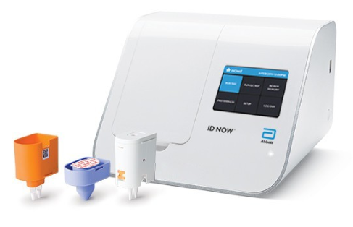
What is the ID NOW™ Instrument?
The ID NOWTM Instrument is a rapid molecular test utilizing isothermal nucleic acid amplification technology (NAAT) for the detection of infectious diseases
ID NOW™ Instrument Platform Menu
Influenza A&B 2
Strep A 2
RSV
COVID-19 2.0 (Emergency Use Authorization)
Front View
Back View
Notes:
General Overview of ID NOW
Rapid molecular test, NEAR technology (depending on audience), CLIA Waived Test
Receiving ID NOW instrument and initial setup (setting admin password, date, and time)
Power cord and where it’s plugged in and USB ports.
Discuss power button location, how to turn on/off instrument, and blinking LED light
Optional Accessories (universal printer and barcode scanner)
1.2 Product Description
ID NOW utilizes isothermal nucleic acid amplification technology for the qualitative
detection of infectious diseases. Consumables such as Test Bases and Sample
Receivers are required to run each assay.
The reaction tubes in the Test Base contain the reagents required for amplification of
the target nucleic acid and an internal control. ID NOW utilizes a pair of templates
(similar to primers) for the specific amplification of the target nucleic acid and
a fluorescently-labeled molecular beacon designed to specifically identify the
amplified targets.
To perform the assay, the Sample Receiver and Test Base are inserted into the
ID NOW Instrument. The sample is added to the Sample Receiver and transferred
via the Transfer Cartridge to the Test Base, initiating target amplification. Heating,
rotation and detection is provided by the instrument, with results automatically
reported.
Additional assay specific information and work flows are detailed in the respective
product inserts.

Slide 8
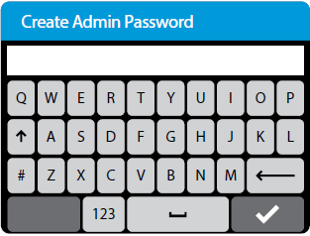
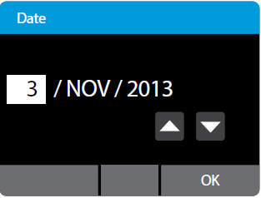
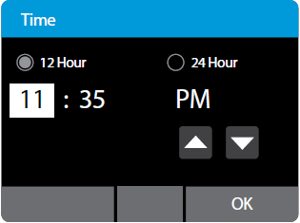
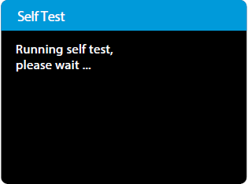
Initial Setup
Connect the 12V power supply to the instrument
Power Up: Once the power is connected, press and hold the Power Button on the right side of the instrument to power up and start the instrument
Create Admin Password
Set the Date
Set the Time
Self Test
Notes:
Connect the 12V power supply to the instrument. Plug the appropriate, country specific adapter into an appropriate electrical outlet.
Power Up once the power is connected, press and hold the Power Button on the right side of the instrument to power up and start the instrument.
Instrument Status Light
The light statuses are:
Slow flash: Starting up/ heaters not at temperature
On solid: Heaters at temperature
Fast flash: Software updates, Hardware fault, or shutting down

Slide 9
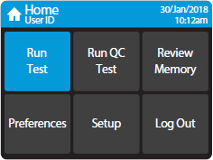
Instrument Home Menu Options
Run Test
  Choose Test Type
  Enter Patient ID
Run QC Test
  External QC Requirements:
    New Instrument
    Untrained Operators
    New Shipment of Kits
    Conforming with local, state, and/or federal regulations, accrediting groups, or lab’s standard QC procedures.
Review Memory
  999 Test Storage
  Export Results
  Export Logfiles
Preferences
Setup (Admin Access Only)
  Add users
  Auto-logout
  Auto-print
  Connectivity
Log Out
Notes:
Discuss the menu options focusing on Run Test, QC, and Review Memory. Briefly discuss Preference and Setup unless it is a superuser training.
Reinforce that the end-user only needs to use: Run Test, Run QC Test, Review Memory and Log Out.

Slide 10
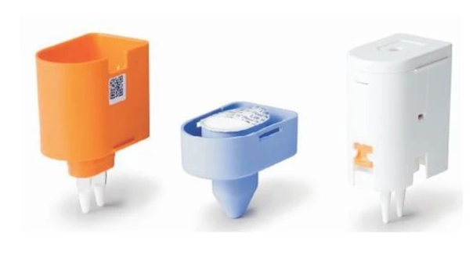
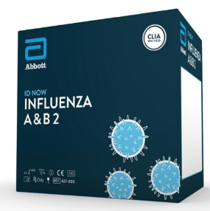
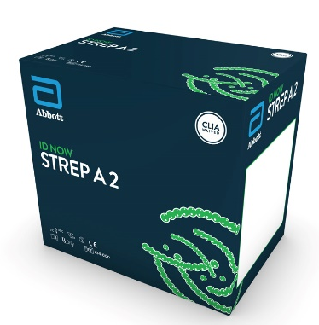
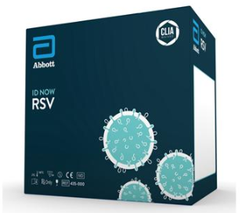
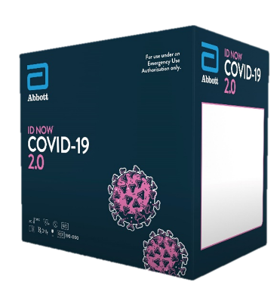
Reagent Overview
Materials Provided
  24 Tests
    Package #1: Test Base
    Package #2: Sample Receiver and Transfer Cartridge
  Patient Collection Swabs
  Positive QC Swab
  Blank Swab for Negative QC
  Product Insert
  Quick Reference Instructions
  Healthcare Provider & Patient Fact Sheet (COVID-19 2.0 Only)
  Plastic Disposable Pipettes (Influenza A&B 2 & RSV Only)
Storage and Stability
  Store at 2-30ºC
  Room temperature before use
  Stable until manufacture’s expiration date marked on outer packaging

Slide 11
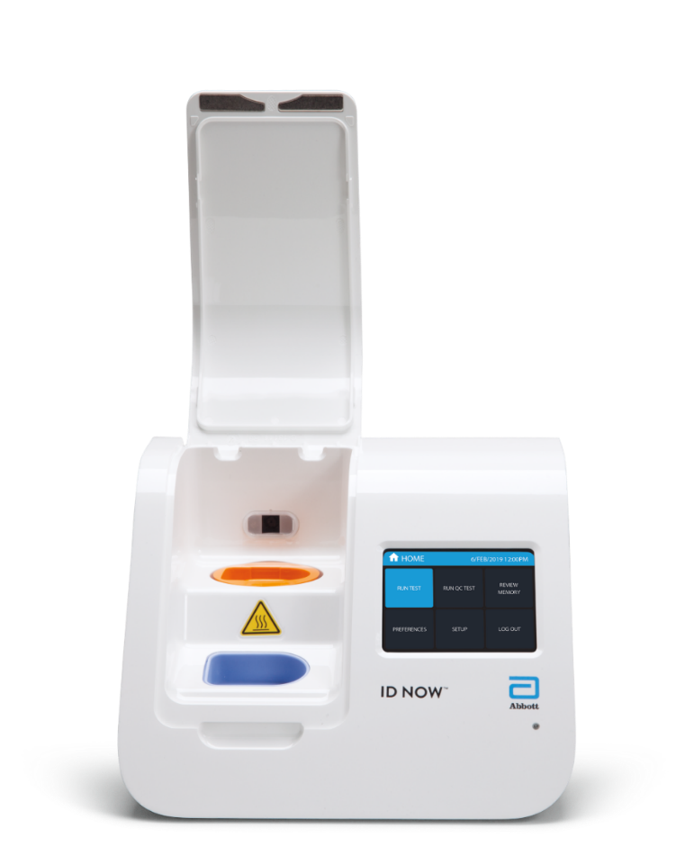
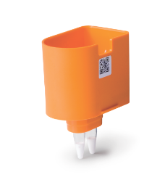
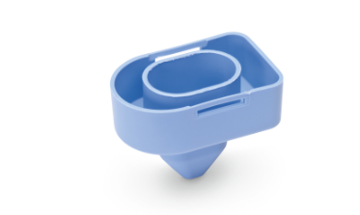
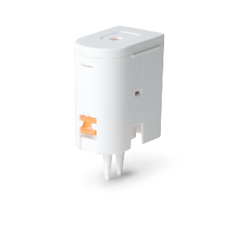
ID NOW™
Testing Components
Orange Test Base
  Contains reagents for the targeted amplification and internal control
Blue Sample Receiver
  Removes sample from swab
  Contains elution/lysis buffer
White Transfer Cartridge
  Transfers sample from the receiver to the test base

Slide 12
Reagent Overview
Influenza A & B 2
Sample Type
Nasal swab
Nasopharyngeal (NP) swab
Nasal or NP swab with VTM
Sample Storage
Direct Swab:
  2 Hours at Room Temperature
  Up to 24 hours at 2-8ºC
VTM:
  8 hours at Room Temperature
  72 hours at 2-8ºC
Positive results in as few as 5 minutes with early detection, negative results in 13 minutes

Slide 13

Reagent Overview
Strep A 2
Sample Type
Throat Swab
Sample Storage
Direct Swab:
  Up to 72 hours at Room Temperature or at 2-8ºC
  Transport Media:
  Throat swab in BBL™ CultureSwab™ Liquid Amies transport media system: Room Temp or 2-8°C up to 6 hrs.
Strep A 2 positive results in as few as 2 minutes, negative results in 6 minutes

Slide 14
Reagent Overview
RSV
Sample Type
Nasopharyngeal (NP) Swab
NP Swab with VTM
Sample Storage
Direct Swab:
  2 Hours at Room Temperature
  Up to 24 hours at 2-8ºC
VTM:
  8 hours at room temperature
  24 hours at 2-8ºC
RSV results in 13 minutes or less

Slide 15
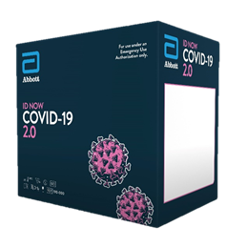
Reagent Overview
COVID-19 2.0 (Emergency Use Authorization)
Sample Type
Nasal Swab
Nasopharyngeal (NP) Swab
Sample Storage
Direct Swab Only:
DO NOT return the swab to its original packaging
Test as soon as possible after collection
  If immediate testing is not possible, and to maintain best performance, it is highly recommended to place the swab in a clean, unused tube labeled with patient information and capped tightly
Up to 1 hour at Room Temperature (15-30°C)
  If greater than 1 hour delay occurs, dispose of the sample & collect a new specimen for testing.
Positive results as early as 6 minutes, negative results in 12 minutes

Slide 16
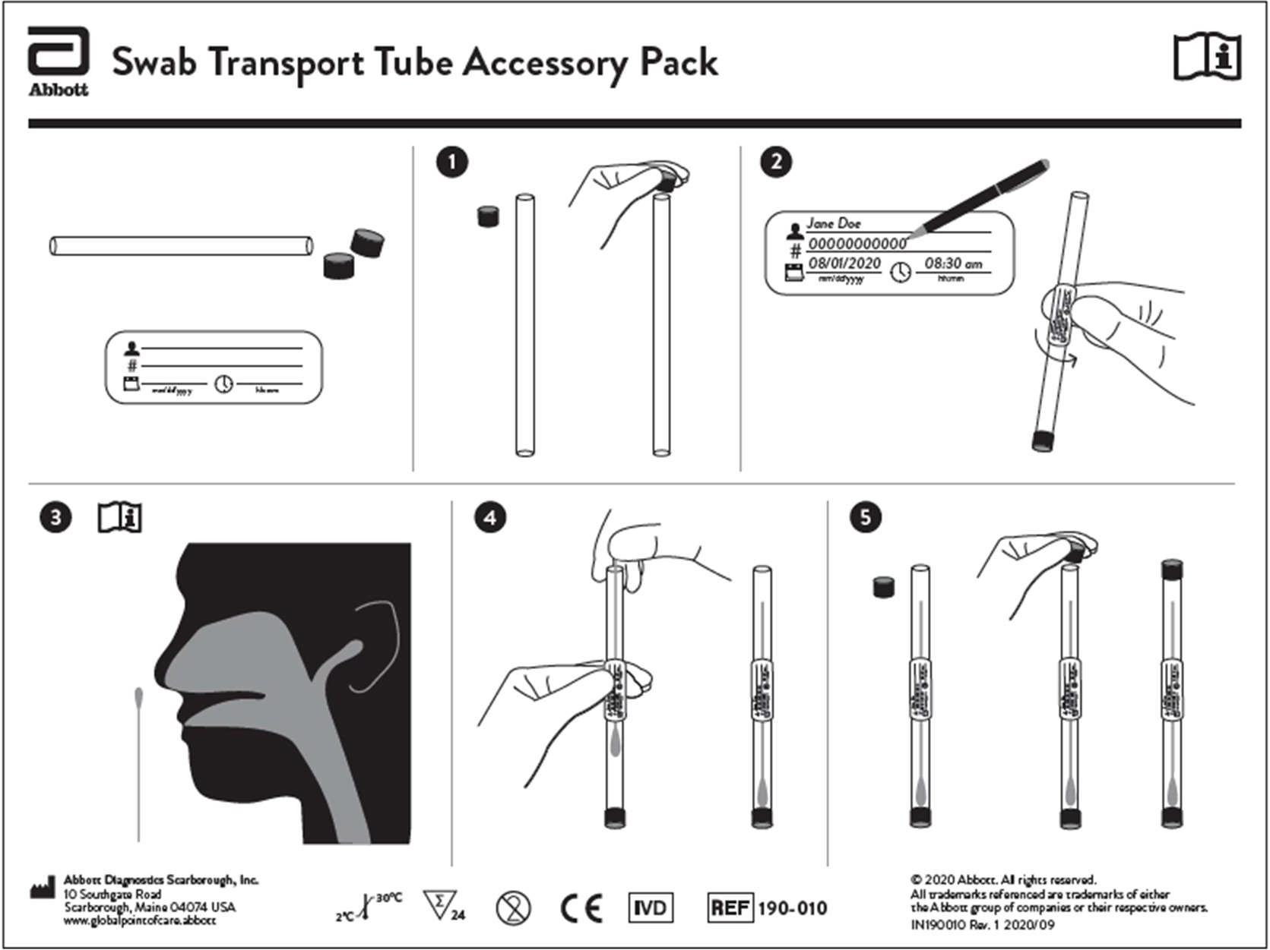
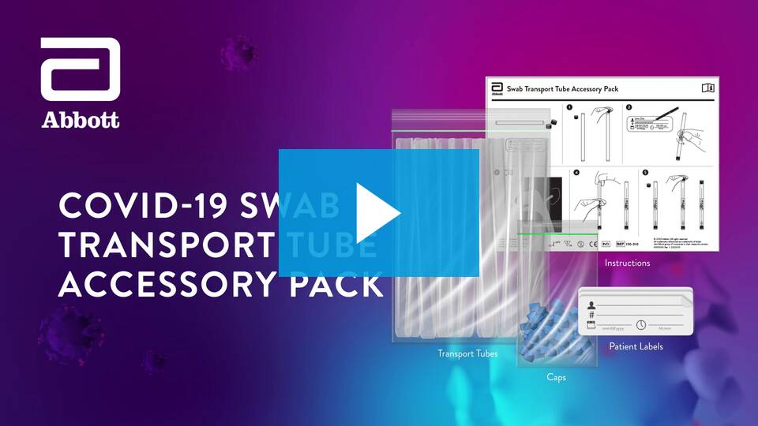

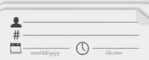
Specimen Transport & Storage
COVID-19 2.0 (Emergency Use Authorization)
COVID-19 Swab Transport Tube Accessory Pack Overview

Slide 17
Reagent Overview
Assays | Influenza A&B 2 | Strep A 2 | RSV | COVID-19 2.0 (*EUA)
Sample Types | Nasal Swab NP Swab Nasal or NP Swab in VTM | Throat Swab | NP Swab NP Swab in VTM | Nasal Swab NP Swab
Direct Sample Storage | RT: up to 2hrs. 2-8°C: up to 24 hrs. | RT up to 72 hrs. 2-8°C up to 72 hrs. | RT: up to 2 hrs. 2-8°C: up to 24 hrs. | RT: up to 1 hr. If immediate testing is not possible, & to maintain best performance, it is highly recommended to place the swab in a clean, unused tube DO NOT return the swab to its original packaging
Transport Media Sample Storage | RT: up to 8 hrs. 2-8°C: up to 72 hrs. | Throat swab in BBL™ CultureSwab™ Liquid Amies transport media system RT or 2-8°C: up to 6 hrs. | RT: Up to 8 hrs. 2-8°C: up to 24 hrs. | Not approved
Testing Time | 13 minutes or less Early positive detection in as few as 5 minutes | 6 minutes or less Early positive detection in as few as 2 minutes | 13 minutes or less | 12 minutes or less Early positive detection in as little as 6 minutes

Slide 18
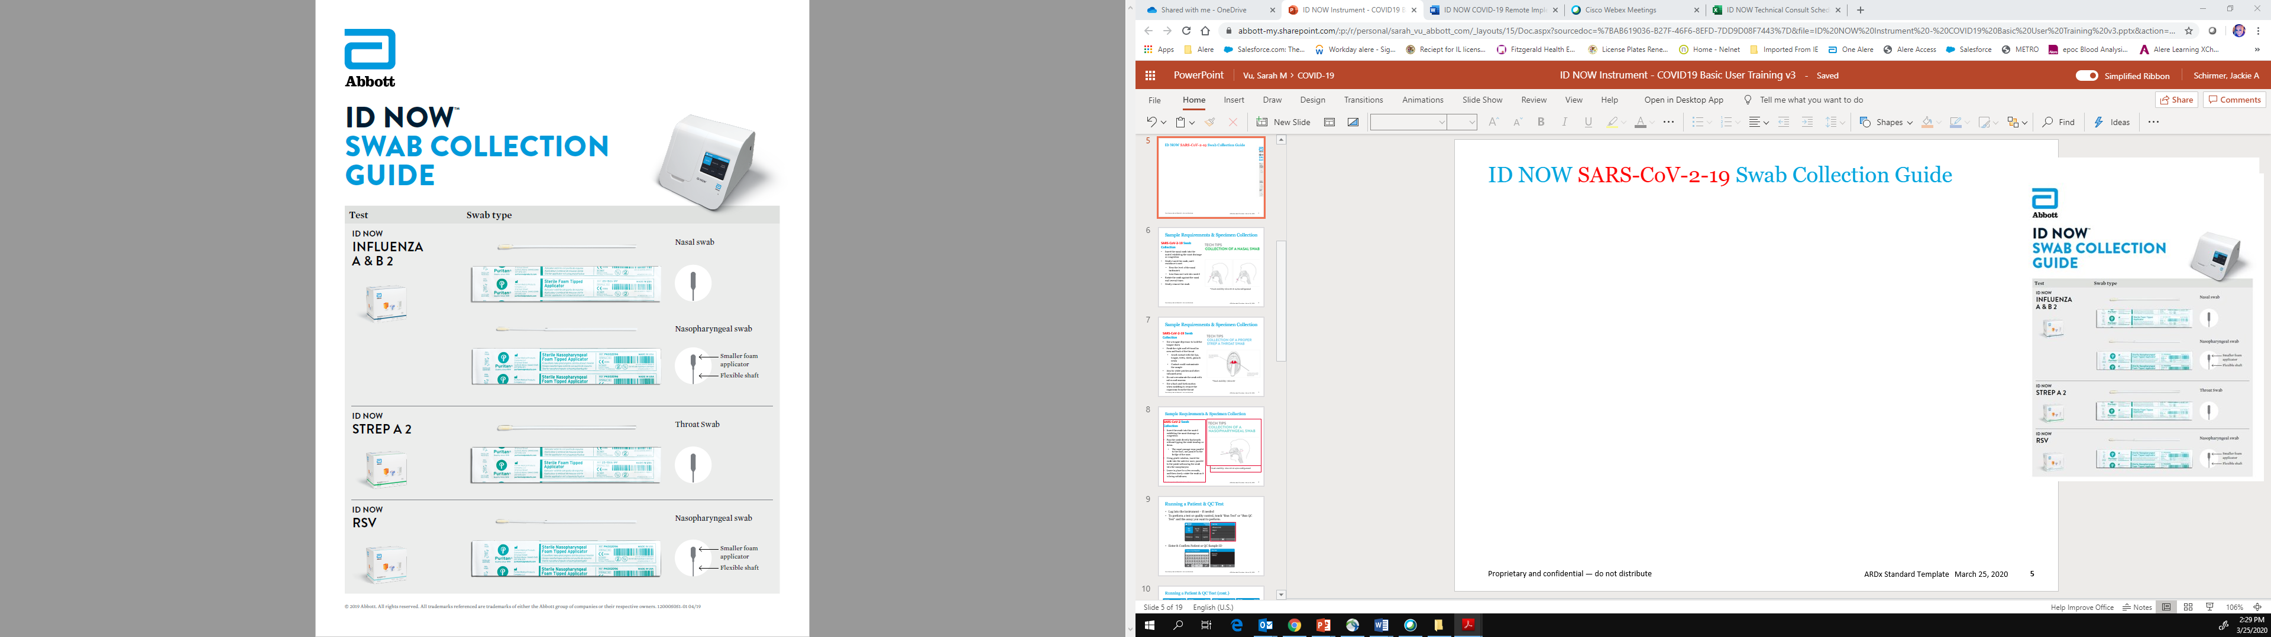
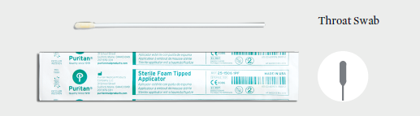
ID NOW Swab Collection Guide
Direct nasal, throat, or nasopharyngeal swabs should be tested as soon as possible after collection. Use freshly collected specimens for optimal test performance
Swab types included in each kit:
Sterile Foam Tipped Applicators:
  Influenza A & B 2
  Strep A 2
  COVID-19 2.0
Sterile Nasopharyngeal Foam Tipped Applicator:
  RSV

Slide 19
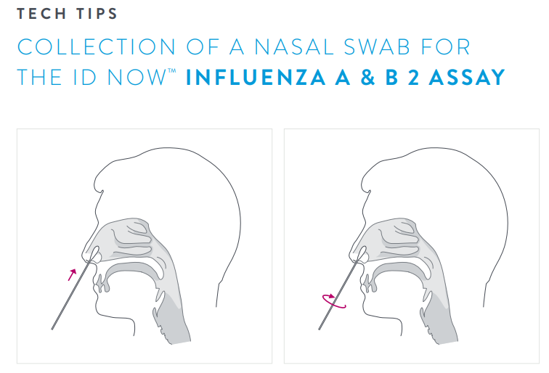
Nasal Swab Sample Collection for Influenza A&B 2
Insert the nasal swab into the nostril exhibiting the most drainage or congestion
Gently insert the swab, until resistance is met
    Near the level of the nasal turbinate's
    Less than one inch into nostril
Rotate the swab against the nasal wall several times
Gently remove the swab

Slide 20
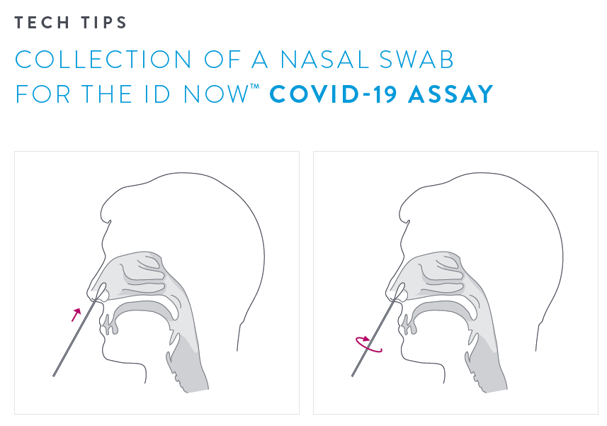
Nasal Swab Sample Collection for COVID-19 2.0
Insert the nasal swab into the nostril exhibiting the most drainage or congestion
Using gentle rotation, insert the swab until resistance is met
    At the level of the nasal turbinates
    Less than one inch into nostril
Rotate the swab several times against the nasal wall
Gently remove the swab
Using the same swab, repeat sample collection in the other nostril
DO NOT return the swab to its original packaging

Slide 21
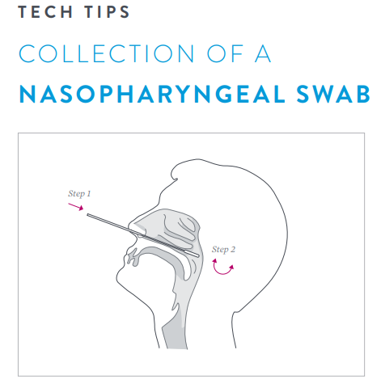
Nasopharyngeal Swab Sample Collection
Insert the swab into the nostril exhibiting the most drainage or congestion
Pass the swab directly backwards without tipping the swab head up or down.
    The nasal passage runs parallel to the floor, not parallel to the bridge of the nose.
    DO NOT use force
Using gentle rotation, insert the swab into the anterior nare parallel to the palate, advancing the swab into the nasopharynx
  Distance is halfway of that from the nose to the tip of the ear and about half the length of the swab
Leave in place for a few seconds, and then slowly rotate the swab as it is being withdrawn.

Slide 22
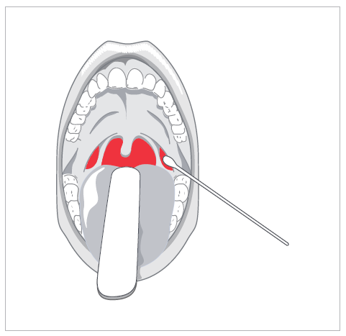
Throat Swab Sample Collection
Use a tongue depressor to hold the tongue down
Swab the right and left tonsillar area and back of the throat with a back-and-forth motion
    Swabbing removes organisms adhering to the throat
    Avoid contact with the lips, teeth, cheek, gums, uvula and tongue
    Contact with these area could contaminate the sample
Aim for white patches and other inflamed areas
Do not oversaturate the swab with saliva and mucous
When using dual swabs, collect bacteria on both sides of the swab head and rub the two heads together to ensure even distribution of the sample.

Slide 23
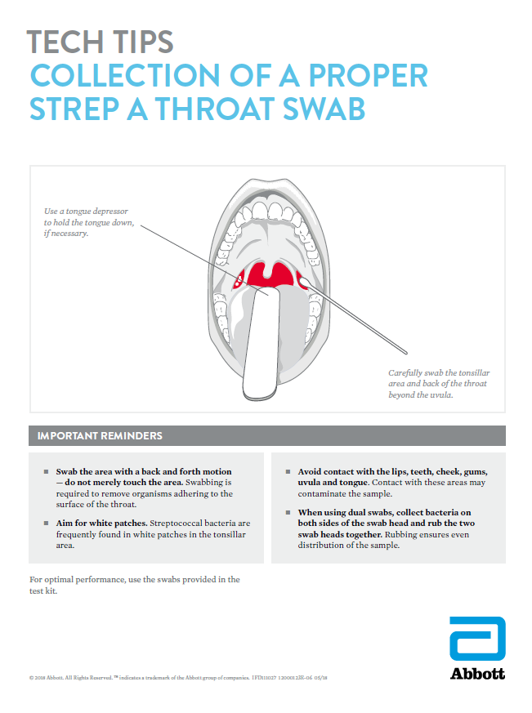
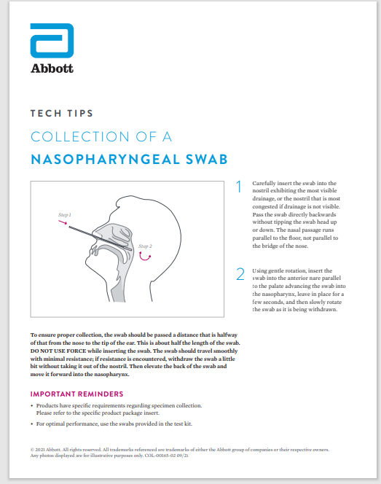
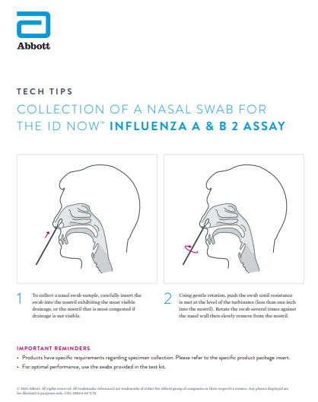
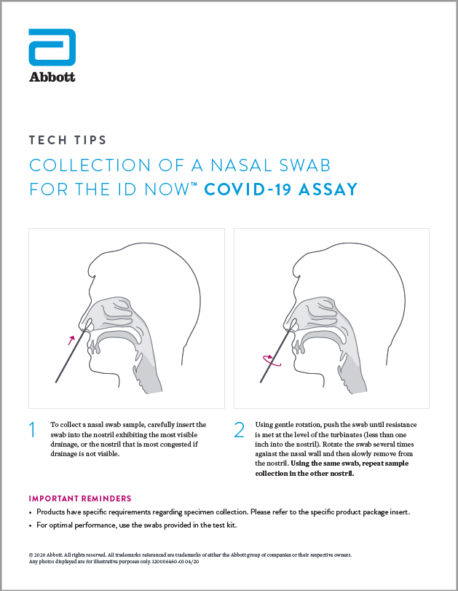
Tech Tips for Proper Sample Collection
Notes:
This slide is to note that we can send Tech Tips on collection electronically to send to clinical educators and staff.

Slide 24
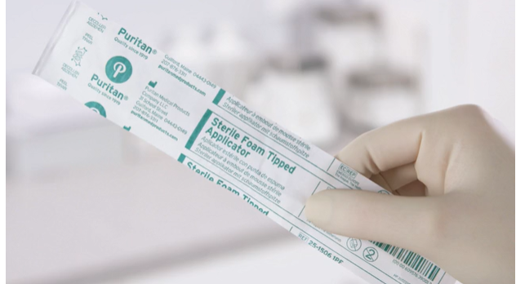
Patient & QC Test Procedure
Before Testing with the ID NOW™ Instrument:
Put on a clean pair of gloves
Allow all samples to reach room temperature
Allow all test pieces to reach room temperature
Check that a reagent pellet is visible at the bottom of each of the reaction tubes prior to inserting the Test Base in the ID NOW instrument
  Do not use the Test Base if a pellet is not visible at the bottom of each reaction tube

Slide 25
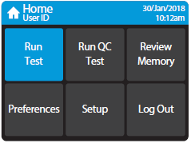
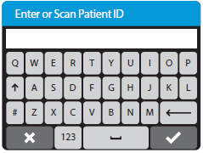
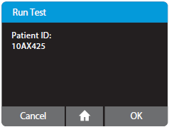
Patient & QC Test Procedure
Log into the instrument – if needed
To perform a test or quality control, touch “Run Test” or “Run QC Test” and the assay you want to perform
Enter & Confirm Patient or QC Sample ID

Slide 26
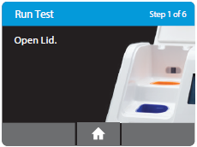
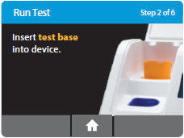
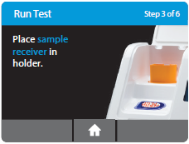
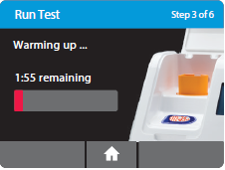
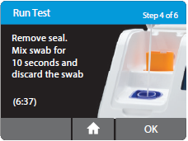
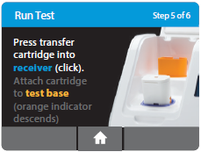
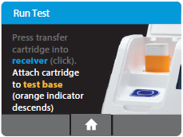
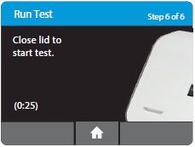


Patient & QC Test Procedure - Direct Swab
Step 1: Open Lid
Step 2: Insert test base into device. Click "OK" to confirm assay type
- 3-minute warm-up period
required for viral assays
No warm-up for bacterial assays
Step 3: Place sample receiver in holder
Step 4: Remove seal. Mix swab for 10 seconds and discard the swab. Click "OK" to initiate the transfer steps.
Step 6: Close lid to start test
Step 5: Press transfer cartridge into receiver. Attach cartridge to test base.
Notes:
Start this by saying there are 6 steps, and the animation on the screen walks you through each step before presenting for live demo.

Slide 27
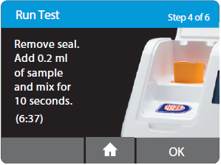
Patient Test Procedure - VTM
Step 1: Open Lid
Step 2: Insert test base into device. Click "OK" to confirm assay type
Step 3: Place sample receiver in holder
3-minute warm-up period required for viral assays
Step 4: Remove seal. Add 0.2 ml of sample and pipette tip to mix for 10 seconds. Touch "OK" to proceed.
Step 6: Close lid to start test
Step 5: Press transfer cartridge into receiver. Attach cartridge to test base.
Notes:
*Reiterate to team if customer is using VTM or not and if they should present this slide.

Slide 28
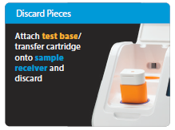
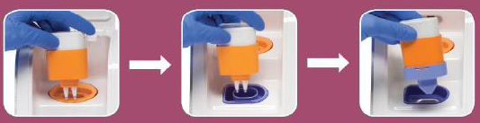
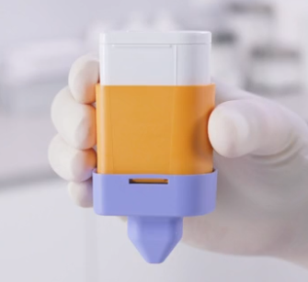
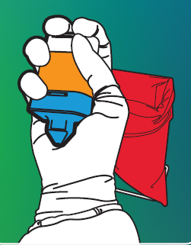


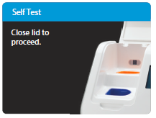
ID NOW™ Assay Disposal
Properly disposing of test components is important to minimizing risk of an amplicon release
Remove test pieces by lifting the Transfer Cartridge attached to the Test Base, and clicking it into the Sample Receiver, by pressing into the Sample Receiver
All test pieces will be connected and can now be removed from the instrument and disposed of according to federal, state and local regulations
Close the instrument lid to initiate self-test.
Notes:
NOTE: I left all the images here to see which one we might like best?

Slide 29
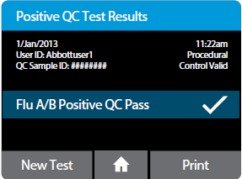
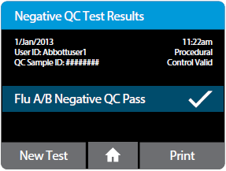
Result Interpretation
Quality Control
QC Test Results
The ID NOW Instrument reports QC results as "Pass" or "Fail"
Flu A/B Positive QC pass indicates a positive result for both Influenza A & B
RSV positive QC pass indicates a positive result for both RSV A and RSV B
If the correct control results are not obtained, contact Technical Support before testing patient specimens

Slide 30





Result Interpretation
Influenza A&B 2
Positive results in as few as 5 minutes, negative results in 13 minutes
Patient Test Results
    Positive: Viral RNA detected
    Negative: Viral RNA not detected
    Dual Positive: Flu A Viral RNA detected; Flu B Viral RNA detected
    Invalid: Presence or absence of viral RNA cannot be determined
If the ID NOW Instrument is set to 'Early Detection', a positive result will be displayed for Influenza A or B immediately upon detection.

Slide 31



Result Interpretation
Strep A 2
Positive results in as few as 2 minutes, negative results in 6 minutes
Patient Test Results
Positive Result: Positive for Strep A nucleic acid
Negative Result: Negative for Strep A nucleic acid
Invalid: Presence or absence of Strep A nucleic acid cannot be determined

Slide 32


Result Interpretation
RSV
Results in 13 minutes or less
Patient Test Results
Positive Result: Positive for RSV viral RNA
Negative Result: Negative for RSV viral RNA
Invalid: Presence or absence of RSV viral RNA cannot be determined

Slide 33



Result Interpretation
COVID-19 2.0 (Emergency Use Authorization)
Positive results as early as 6 minutes, negative results in 12 minutes
Patient Test Results
Positive Result: COVID-19 positive
Negative Result: COVID-19 negative
  Negative results do not preclude SARS-CoV-2 infection
Invalid: Presence or absence of COVID-19 viral RNAs cannot be determined
Note for COVID-19 2.0: Please review the Emergency Use Authorization provided to your facility for results, reporting, and other obligations
Notes:
*Will edit once w eknow mo

Slide 34


Invalid Test Results
Main Causes for Invalid Test Results
Sample dispense errors
    “Invalid, possible dispense issue” will display if an insufficient amount of sample was transferred to the test base.
    When transferring the sample, be sure to visually observe the orange indicator both rise and fully descend to assure a complete sample dispense before closing the instrument lid
Procedural errors
    Be sure to follow all the instrument prompts and timing
Interfering substances
    Adequate and accurate specimen collection
* If unexplained, invalid or false test results continue to be obtained after repeating test, please contact Technical Support at 855.731.2288

Slide 35

Repeat Testing
If an Invalid result is received, one additional test may be run using the same blue Sample Receiver
Refer to ID NOW Performance Best Practices for repeat testing procedures
If unexplained, invalid, or false positive results continue to be obtained, please contact Technical Support for assistance at 855-731-2288
Notes:
I

Slide 36

Molecular Considerations
“Amplicons” are amplified copies of the target DNA or RNA
Present in the orange test base reaction tubes after the testing process is complete
If the orange test base is damaged or compromised, these “amplicons” are released, contaminating the workspace and testing environment
“Amplicons” cannot make you sick, but may cause false positive results
The risk for amplicon release is very low if test components are handled and discarded appropriately
To Avoid Amplicon Release:
Use caution when opening and handling package #1 – the orange test base
Discard and DO NOT use any components that are dropped, cracked or found to be damaged.
Test components must NEVER be discarded individually
Once the test components are assembled after the test is complete, NEVER disassemble them
Clean the instrument daily

Slide 37
Maintenance and Cleaning
The ID NOW Instrument is maintenance-free and has no serviceable parts
Clean instrument daily
Acceptable cleaning agents include the following:
  70% ethanol or 70% isopropanol– available in commercial wipes or on a damp, lint free cloth
  10% bleach – on a damp, lint free cloth only
Wipe down exterior instrument surfaces and the surfaces visible under the lid
Never spray or pour any liquid on the instrument directly – avoid excessive moisture

Slide 38

ID NOW Training Modules

Slide 39
Questions?
The ID NOW COVID-19 2.0 EUA has not been FDA cleared or approved. It has been authorized by the FDA under an emergency use authorization for use by authorized laboratories and patient care settings. The test has been authorized only for the detection of nucleic acid from SARS-CoV-2, not for any other viruses or pathogens, and is only authorized for the duration of the declaration that circumstances exist justifying the authorization of emergency use of in vitro diagnostic tests for detection and/or diagnosis of COVID-19 under Section 564(b)(1) of the Act, 21 U.S.C. § 360bbb-3(b)(1), unless the authorization is terminated or revoked sooner.

Slide 40
© 2022 Abbott. All rights reserved. All trademarks referenced are trademarks of either the Abbott group of companies or their respective owners. Any photos displayed are for illustrative purposes only. COL-07564-01 07/22

